Slide 1

Google Bigtable
A Distributed Storage System for Structured Data
Paper: Chang et. al
Slides: Ryan W. West
ryan@ryanwwest.com
September 2021
Notes:
Paper source and image/quote references throughout can be found at https://static.googleusercontent.com/media/research.google.com/en//archive/bigtable-osdi06.pdf

Slide 2
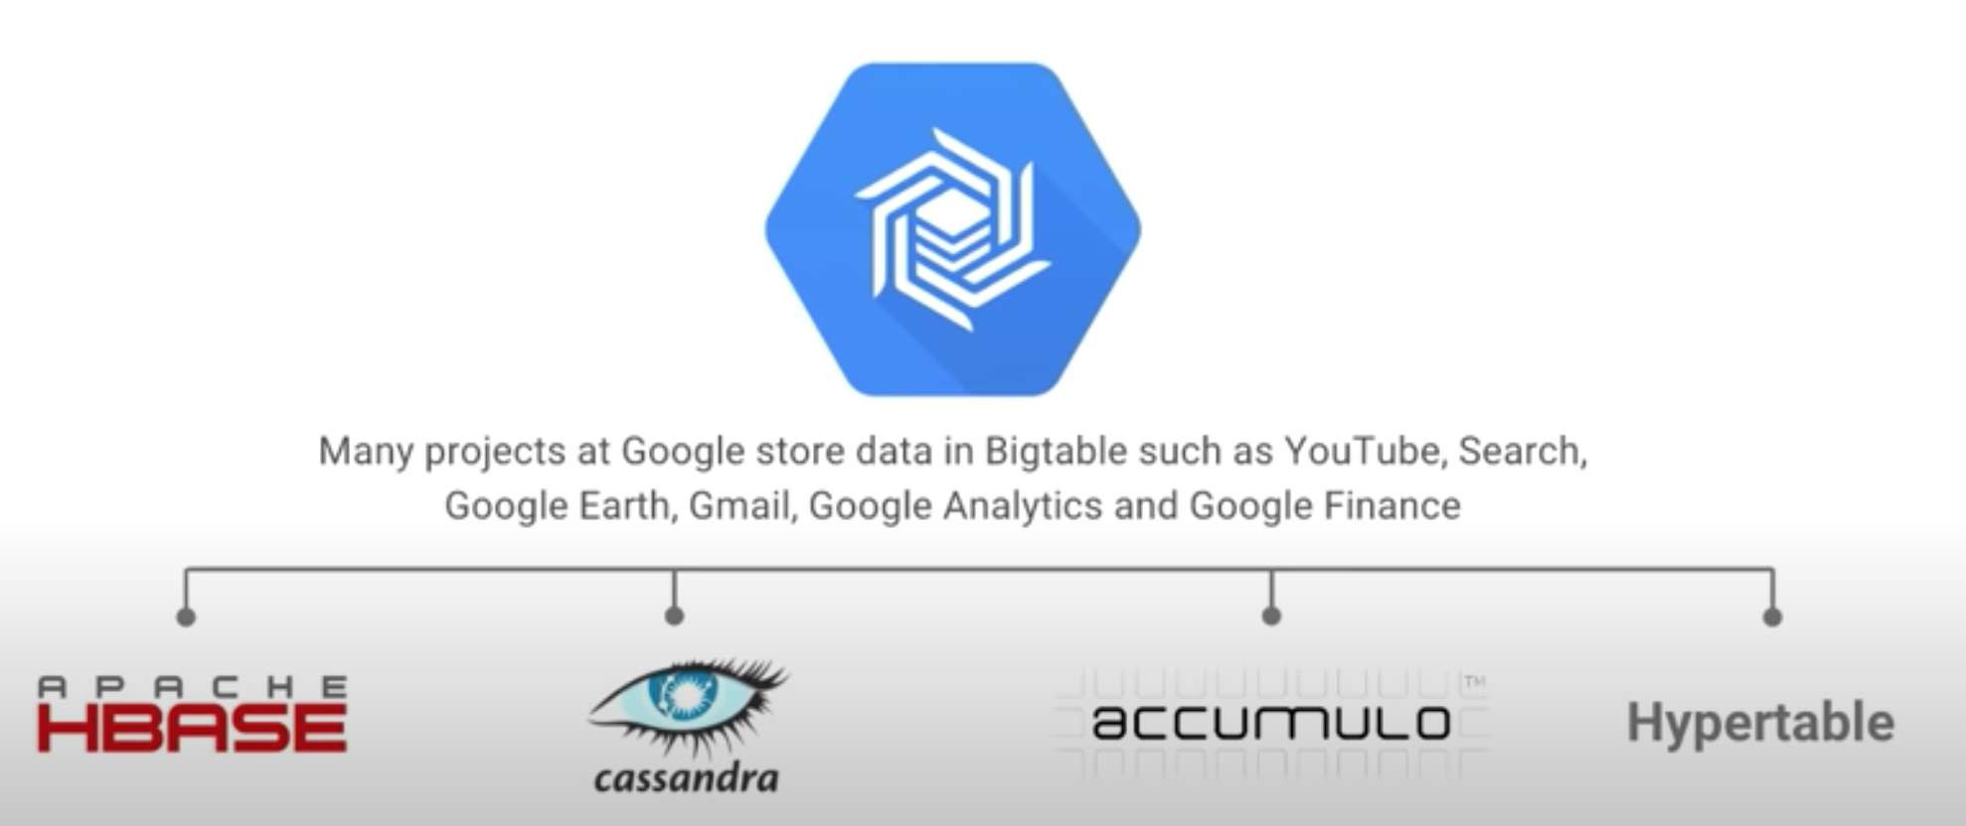
What is Bigtable?
Bigtable is a distributed storage system optimized for size and price:
Can scale to petabytes of data with fast speeds
Can run on cheap commodity hardware (1GB RAM servers in 2006)
Widely used in 2021
Used by Google Search, Maps, Analytics, Finance, and more
Closed-source but available for public use through Google Cloud Platform (GCP)
Used by Twitter, PayPal, UPS…
NoSQL Wide-column DB family
Notes:
Some Bigtable client servers and APIs appear to be open-sourced, but I think the main service is closed-source despite some presentations claiming otherwise.
A columnar NoSQL database is known for a similar idea of SQL-like table and column/row storage ; however, the number of columns in a row can change; there is much more flexibility but sometimes SQL queries can’t function as a result (as is the case here).
Image source: https://www.youtube.com/watch?v=KaRbKdMInuc at 3:55

Slide 3
Main Features
Simple Data Model — NoSQL-like relational querying
Dynamic control over data layout and format
Can be configured for high throughput or low latency
Live Cluster resizing, automatic replication
Data is automatically compressed, can configure the algorithm

Slide 4
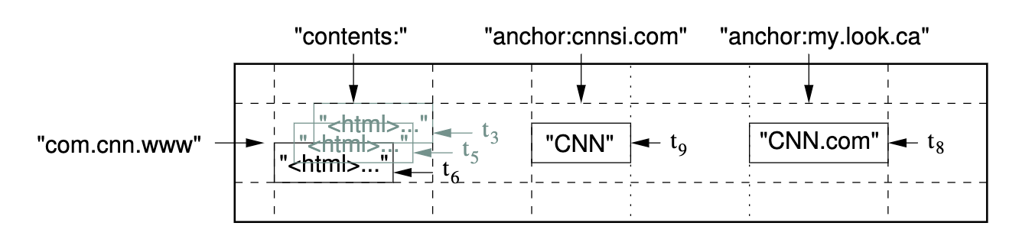
Data Model
“A Bigtable is a sparse, distributed, persistent multidimensional sorted map.”
Map data is indexed with Row Keys, Column Keys, and Timestamps
Multiple similar columns can be grouped into a column family for faster compression/operations
Notes:
Data also supports versioning (see the 3 versions in the “contents:” column data in the example) which can be configured per tablet by the user
Each row-column-timestamp data value is a cell.

Slide 5
Data Model
Data is atomically read/written in full rows with the row key (row size <100MB)
Rows are sorted lexicographically
Allows users to exploit locality for better read performance by carefully ordering their row-keys
Google’s webpage table stores URLs in reverse so subdomains (money.cnn.com) are together
Notes:
To expound on exploiting read performance, rows are stored contiguously in memory or on disk so the system has to do less reads and fetches overall if a group of nearby rows is requested. This doesn’t impact write performance quite as much according to the paper performance evaluation.
There are other types of reads and writes; see 17:38 at https://www.youtube.com/watch?v=KaRbKdMInuc. But in the paper, it is usually full reads and writes and less flexible than relational logic
Row size should be <100 MB but maybe doesn’t have to be.

Slide 6
Architecture
A range of rows is a tablet - the unit of distribution and load-balancing
A set of tablets (each 100-200 MB by default) makes a table
Three major components make up a Bigtable cluster:
Master server | Tablet servers | Client libraries
Assigns tablets to tablet servers Balances tablet-server load Garbage-collects old tablets Schema changes (to column-families) Only one, low load | Manages a set of tablets (~10-1000) Handles read/write requests to its tablets Splits tablets that grow too large Dynamically added / removed from cluster | An API is provided to manage the cluster, read/write data, etc. Done not through master but directly through tablet servers Some clients are open-sourced online
Notes:
When a tablet server dies, the master server will redistribute its tablets to other tablet servers. If it died gracefully, this can be performed much faster; otherwise, the master has to detect the issue first.

Slide 7
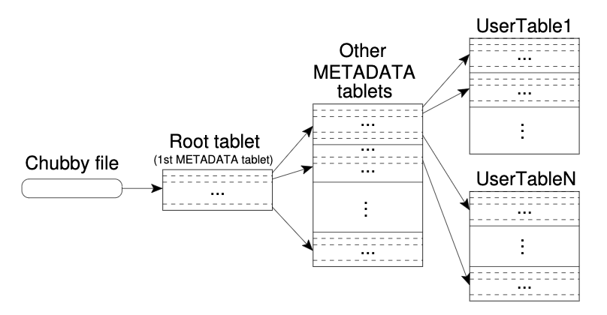
Architecture
Bigtable relies on Chubby, a highly-available distributed lock service
Uses GFS (Google File System) underneath to store & replicate data files
Data addressing structure:
Chubby file contains root tablet’s location
Root tablet contains locations of all other metadata tablets
Metadata tablets contain location of all other tablets (in tables)
Notes:
This system can address up to 2^34 tablets or 2^61 bytes!
I don’t think Bigtable does tablet replication on its own; it seems it relies on GFS for that, which is abstracted away.

Slide 8
Tablet Assignment
A tablet is assigned to one tablet server at a time through an exclusive Chubby lock
Master server detects unassigned tablets and tablet servers that no longer serve their tablets, and quickly moves such tablets to new tablet servers
Master continually communicates with tablet servers to ensure metadata (addressing) tablets are up-to-date
Notes:
Similarly, the master server acquires a unique master Chubby lock so there can only be at most one master

Slide 9
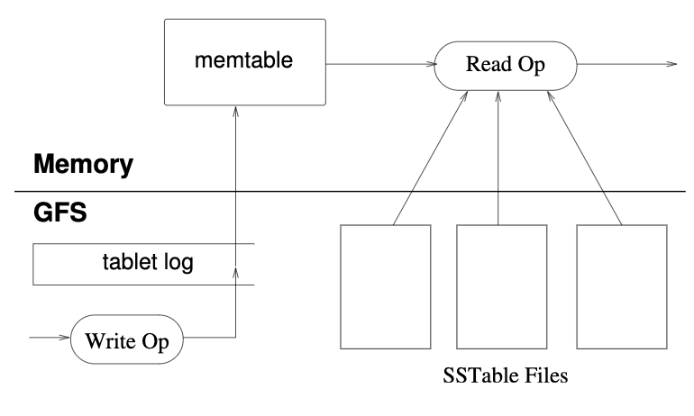
Tablet Serving
Updates are stored in a tablet commit log on GFS (Google File System) then committed to an in-memory memtable
If memtable grows too large, it is frozen, compacted, and converted to an SSTable on disk
A new memtable is created
SSTables allow for quick transfer and recovery of tablets
Notes:
There are other types of compactions (major, merging) behind the scenes that can consolidate SSTable files or and remove deletion information (for
A major compaction; important for sensitive files)
Quick recovery is possible since a new tablet server just needs to access the existing SSTable Files and apply the updates in the memtable on top of them, which is relatively fast since memtable isn’t large. Also, since SSTables are immutable, no synchronization of accesses to file system is required. Only memtable is mutable and requires concurrency/consistency checks.

Slide 10
Refinements
Locality groups - groups of column families, allows for more efficient reads (a user who wants webpage metadata need not fetch page contents)
Compression - SSTables can be compressed for space or not for speed
Caching of SSTable key-value pairs & entire SSTable blocks read from GFS
Bloom filters - allows tablet server to ask if each SSTable might contain data for a certain row/column pair.
Allows certain read processing to skip scanning large amounts of SSTables of a tablet
Notes:
This is not an exhaustive list; some left-out refinements are in the paper

Slide 11
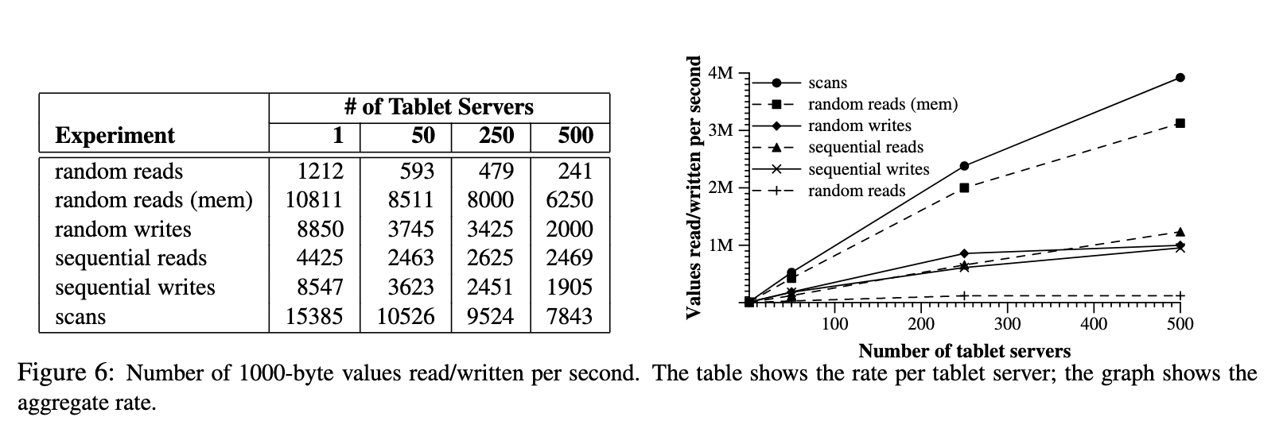
Performance Benchmarks
Notes:
Mem stands for in-memory reads
Remember a tablet is 100-200 MB, when these were done in 2006
Scans uses a Bigtable API for scanning all values in a range, “reduces RPCs since a single RPC fetches a large sequence of values from tablet a server.”

Slide 12
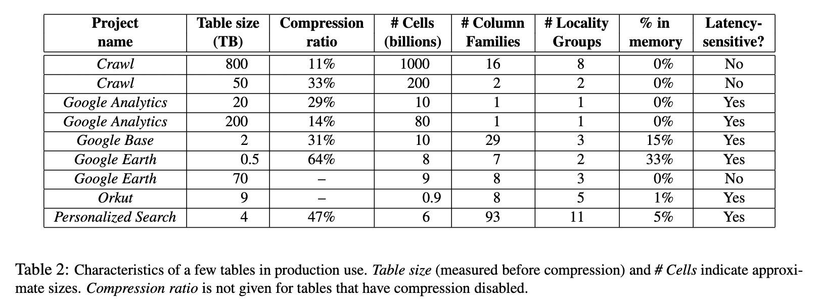
Real Cluster Examples (in 2006)

Slide 13
My Thoughts
Shows that many different data models work
A simple model can work well; no SQL querying can work well
Few databases can scale to petabytes in a single cluster
Wish it were open-sourced
Could have third-party security audits this way
But might not be possible with dependency on GFS and Chubby (also closed-source)
Notes:
This includes my opinion and highlights of what I’ve learned

